Slide 1


Course Project Machine Learning and Data Mining
TRƯỜNG ĐẠI HỌC BÁCH KHOA HÀ NỘI
HANOI UNIVERSITY OF SCIENCE AND TECHNOLOGY
SoICT - 2020

Slide 2
TRƯỜNG ĐẠI HỌC BÁCH KHOA HÀ NỘI
HANOI UNIVERSITY OF SCIENCE AND TECHNOLOGY
Member:
Đào Hoài Nam – 20173271 Nguyễn Kiên Trung – 20173421
Nguyễn Khương Duy – 20173072
Phạm Thành Đông - 20173020
Teacher : Nguyễn Nhật Quang
SoICT - 2020

Slide 3
Subject : Detect spam email
TRƯỜNG ĐẠI HỌC BÁCH KHOA HÀ NỘI
HANOI UNIVERSITY OF SCIENCE AND TECHNOLOGY
SoICT - 2020

Slide 4
TRƯỜNG ĐẠI HỌC BÁCH KHOA HÀ NỘI
HANOI UNIVERSITY OF SCIENCE AND TECHNOLOGY
Outine
Problem definition
2. Traditional approach
3. Our solution
4. Experiment and result
5. Related Work
6. Conclusions and future work

Slide 5
TRƯỜNG ĐẠI HỌC BÁCH KHOA HÀ NỘI
HANOI UNIVERSITY OF SCIENCE AND TECHNOLOGY
Outine
Problem definition
2. Traditional approach
3. Our solution
4. Experiment and result
5. Related Work
6. Conclusions and future work

Slide 6
TRƯỜNG ĐẠI HỌC BÁCH KHOA HÀ NỘI
HANOI UNIVERSITY OF SCIENCE AND TECHNOLOGY
Problem Definiton
Detect spam email as its name, is a work to classify 2 basic types of email: Spam or Ham Email
In today’ digital economy, when every body, every organize can have an email account, when every body can easily create a huge of emails, and when every body can send them to many many other accounts. You click it, your email box open the email, and you start to read content… The content is not relevant your need or your interesting ☹
You waste 10s in your life ☹
… And what happen if you open at least 10 emails in one day
It’s crazy …!

Slide 7
TRƯỜNG ĐẠI HỌC BÁCH KHOA HÀ NỘI
HANOI UNIVERSITY OF SCIENCE AND TECHNOLOGY
Outine
Problem definition
2. Traditional approach
3. Our solution
4. Experiment and result
5. Related Work
6. Conclusions and future work

Slide 8
TRƯỜNG ĐẠI HỌC BÁCH KHOA HÀ NỘI
HANOI UNIVERSITY OF SCIENCE AND TECHNOLOGY
Outine
Traditional approach
This problem is solved as soon as it comes
In traditional approach, we can detect or block spam email by:
Black list or white list
Rules based
… and many other approachs

Slide 9
TRƯỜNG ĐẠI HỌC BÁCH KHOA HÀ NỘI
HANOI UNIVERSITY OF SCIENCE AND TECHNOLOGY
Traditional approach
…. But all of them have some problems :(
Limited receiver
No genalization
Not block all spam accounts or spam IPs

Slide 10
TRƯỜNG ĐẠI HỌC BÁCH KHOA HÀ NỘI
HANOI UNIVERSITY OF SCIENCE AND TECHNOLOGY
…. So how we can solve the problem ???

Slide 11
TRƯỜNG ĐẠI HỌC BÁCH KHOA HÀ NỘI
HANOI UNIVERSITY OF SCIENCE AND TECHNOLOGY
Outine
Problem definition
2. Traditional approach
3. Our solution
4. Experiment and result
5. Related Work
6. Conclusions and future work

Slide 12
TRƯỜNG ĐẠI HỌC BÁCH KHOA HÀ NỘI
HANOI UNIVERSITY OF SCIENCE AND TECHNOLOGY
Our solution
Based on modern approach to solve the problem
With meachine learning approach and a huge of data, we can handle the problem in easier way…

Slide 13
TRƯỜNG ĐẠI HỌC BÁCH KHOA HÀ NỘI
HANOI UNIVERSITY OF SCIENCE AND TECHNOLOGY
We use some algorithms and technical , which is back bone in our solution.
Random forest
Gridsearch + Pipeline
Adaboost

Slide 14
TRƯỜNG ĐẠI HỌC BÁCH KHOA HÀ NỘI
HANOI UNIVERSITY OF SCIENCE AND TECHNOLOGY
Our solution – Data preprocess
The data we have is a csv file, which has 2 fields.
The first field is content of email we need to detect
And one is label of it, 1 for spam emails and 0 for ham emails

Slide 15
TRƯỜNG ĐẠI HỌC BÁCH KHOA HÀ NỘI
HANOI UNIVERSITY OF SCIENCE AND TECHNOLOGY
Our solution – Data preprocess
We met a small trouble when we load dataset from local to goole colab - the environment we work.
It is small trouble but made us have a headache ☹
This is encode character !
When we use encode UTF-8 we have some red message that can’t load our dataset???
WHY???

Slide 16
TRƯỜNG ĐẠI HỌC BÁCH KHOA HÀ NỘI
HANOI UNIVERSITY OF SCIENCE AND TECHNOLOGY
Our solution – Data preprocess
So in our study, it occurred because UTF8 can’t encode somes characters in dataset☹
We solved the trouble by encode latin-1 !!!
… And it works!

Slide 17
TRƯỜNG ĐẠI HỌC BÁCH KHOA HÀ NỘI
HANOI UNIVERSITY OF SCIENCE AND TECHNOLOGY
Our solution – Data preprocess
After that, in dataframe we loaded to gg colab, its have many many fields NaN @@
It sometimes occurs and we don’t know why, but we can handle it!
By choose 2 field we need ☺

Slide 18
TRƯỜNG ĐẠI HỌC BÁCH KHOA HÀ NỘI
HANOI UNIVERSITY OF SCIENCE AND TECHNOLOGY
Our solution – Data preprocess
We not only did that, but also remove null or duplicate value.
.. And

Slide 19
TRƯỜNG ĐẠI HỌC BÁCH KHOA HÀ NỘI
HANOI UNIVERSITY OF SCIENCE AND TECHNOLOGY
Out solution – Data visualize
To explore the distribution of data, we use bar chart to visualize our data we have.
The number of 0 label is more than 1 label.
We need to pay attention that thing!

Slide 20
TRƯỜNG ĐẠI HỌC BÁCH KHOA HÀ NỘI
HANOI UNIVERSITY OF SCIENCE AND TECHNOLOGY
Our solution – Buil model
We used RandomForest, is one of the state-of-art algorithms in ensembling group.
RandomForest is built by many many decision trees.
The key ideas is major vote .
Its meaning is such as you have 10 decision tree, 3 trees in them vote an email is spam, and 7 trees vote ham.
-> So easily the email is ham ☺
In basically, if we have more decision trees we can more predict exactly…
but it isn’t always right !

Slide 21
TRƯỜNG ĐẠI HỌC BÁCH KHOA HÀ NỘI
HANOI UNIVERSITY OF SCIENCE AND TECHNOLOGY
Our solution – Buil model
We used RandomForest, is one of the state-of-art algorithms in ensembling group.
RandomForest is built by many many decision trees.
The key ideas is major vote .
Its meaning is such as you have 10 decision tree, 3 trees in them vote an email is spam, and 7 trees vote ham.
-> So easily the email is ham ☺
In basically, if we have more decision trees we can more predict exactly…
but it isn’t always right !

Slide 22
TRƯỜNG ĐẠI HỌC BÁCH KHOA HÀ NỘI
HANOI UNIVERSITY OF SCIENCE AND TECHNOLOGY
Our solution – Buil model
In RandomForest algorithm we have some hyperparameters, and each parameter can make model have other predict. So we use a technical call GridSearch to find the best set of hyperparameter in many hyperparameter we chose
It’s a good idea, but ….
GridSearch process is very very long time ☹
So how can we improve our performance ???

Slide 23
TRƯỜNG ĐẠI HỌC BÁCH KHOA HÀ NỘI
HANOI UNIVERSITY OF SCIENCE AND TECHNOLOGY
Our solution – Buil model
To solve the problem, we use a technical call Pipeline
Pipleline is a technical to speed up Grid search process. We put it together in our implement

Slide 24
TRƯỜNG ĐẠI HỌC BÁCH KHOA HÀ NỘI
HANOI UNIVERSITY OF SCIENCE AND TECHNOLOGY
Our solution – Buil model
Finally, we use an other algorithm to power up our predict
It’s Ada boost algorithm!

Slide 25
TRƯỜNG ĐẠI HỌC BÁCH KHOA HÀ NỘI
HANOI UNIVERSITY OF SCIENCE AND TECHNOLOGY
Our solution – Buil model
Adaboost is one of the ensembling algorithms.
Wait….
Adaboost and Random Forest is same ???

Slide 26
TRƯỜNG ĐẠI HỌC BÁCH KHOA HÀ NỘI
HANOI UNIVERSITY OF SCIENCE AND TECHNOLOGY
Our solution – Buil model
It’s interesting question ☺
The answer is NO!
Random Forest
Each tree have different part of dataset All tree have have same dataset
All trees have the same weight in voting Each tree have diffirent weight in voting
Adaboost

Slide 27
TRƯỜNG ĐẠI HỌC BÁCH KHOA HÀ NỘI
HANOI UNIVERSITY OF SCIENCE AND TECHNOLOGY
Our solution – Buil model
The answer is NO!
Adaboost
Random Forest
Bagging: Training a bunch of individual models in a parallel way. Each model is trained by a random subset of the data
Boosting: Training a bunch of individual models in a sequential way. Each individual model learns from mistakes made by the previous model.

Slide 28
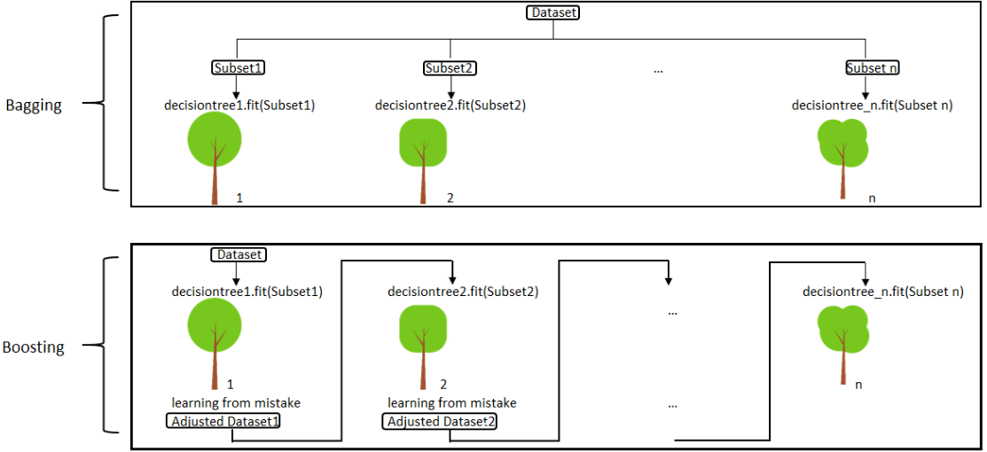
TRƯỜNG ĐẠI HỌC BÁCH KHOA HÀ NỘI
HANOI UNIVERSITY OF SCIENCE AND TECHNOLOGY
Our solution – Buil model
The answer is NO!

Slide 29
TRƯỜNG ĐẠI HỌC BÁCH KHOA HÀ NỘI
HANOI UNIVERSITY OF SCIENCE AND TECHNOLOGY
Outine
Problem definition
2. Traditional approach
3. Our solution
4. Experiment and result
5. Related Work
6. Conclusions and future work

Slide 30
TRƯỜNG ĐẠI HỌC BÁCH KHOA HÀ NỘI
HANOI UNIVERSITY OF SCIENCE AND TECHNOLOGY
Experiment and result
Obiviously, we need to treat ham and spam emails is diffirent! We feel uncomfortable when the regular mail is often put in the spam box than the spam mail is put into the regular mail ☹
How we can do it in our implement ???

Slide 31
TRƯỜNG ĐẠI HỌC BÁCH KHOA HÀ NỘI
HANOI UNIVERSITY OF SCIENCE AND TECHNOLOGY
Experiment and result
Probability!!!
By default, 0.5 is thresold to classify 2 class.
So we lower the thresold .
This change makes the number of actually ham email put in the spam box fewer ☺ The thresold be selected by experiment

Slide 32
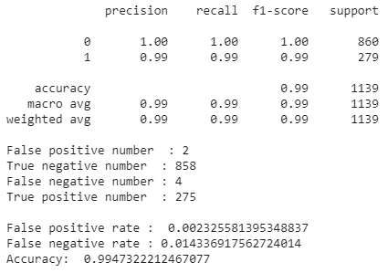
TRƯỜNG ĐẠI HỌC BÁCH KHOA HÀ NỘI
HANOI UNIVERSITY OF SCIENCE AND TECHNOLOGY
Experiment and result

Slide 33
TRƯỜNG ĐẠI HỌC BÁCH KHOA HÀ NỘI
HANOI UNIVERSITY OF SCIENCE AND TECHNOLOGY
Experiment and result - Evalution
The goal is both of precision and recall as higher as better, not only as we said, we need to pay attention the unbalanced class distribution
So f1 is the best choice in this case!
We use f1-score to evaluate model.

Slide 34
TRƯỜNG ĐẠI HỌC BÁCH KHOA HÀ NỘI
HANOI UNIVERSITY OF SCIENCE AND TECHNOLOGY
Experiment and result - Evalution
Base on f1- score we can realize the predict is not bad ☺
But do not be excited too soon !
One of the most important factors in the model is generality
With some new domains such as: cannabis trade, sex trade, or any thing
Our model can keep up its form ???

Slide 35
TRƯỜNG ĐẠI HỌC BÁCH KHOA HÀ NỘI
HANOI UNIVERSITY OF SCIENCE AND TECHNOLOGY
Outine
Problem definition
2. Traditional approach
3. Our solution
4. Experiment and result
5. Related Work
6. Conclusions and future work

Slide 36
TRƯỜNG ĐẠI HỌC BÁCH KHOA HÀ NỘI
HANOI UNIVERSITY OF SCIENCE AND TECHNOLOGY
Related Work
Some approaches solve same problem A novel email abstraction scheme for spam detection
https://dl.acm.org/doi/10.1145/1458082.1458296
Active Learning for Spam Email Classification
https://dl.acm.org/doi/abs/10.1145/3377713.3377789 Machine learning approach for filtering spam emails
https://dl.acm.org/doi/abs/10.1145/2799979.2800043

Slide 37
TRƯỜNG ĐẠI HỌC BÁCH KHOA HÀ NỘI
HANOI UNIVERSITY OF SCIENCE AND TECHNOLOGY
Outine
Problem definition
2. Traditional approach
3. Our solution
4. Experiment and result
5. Related Work
6. Conclusions and future work

Slide 38
TRƯỜNG ĐẠI HỌC BÁCH KHOA HÀ NỘI
HANOI UNIVERSITY OF SCIENCE AND TECHNOLOGY
Conclusions and future work
In this report we approach this problem by using RandomForest and Adaboosting
In the future we plan to improve our model with some key ideas:
Combine many model to predict such as SVM, naïve bayes, NN,….. Each model have different weight in voting
Use AutoMl to choose the best mode
Very challenging and interesting way : Use GAN
Combine traditional approach filter by domain names or domain IP

Slide 39
TRƯỜNG ĐẠI HỌC BÁCH KHOA HÀ NỘI
HANOI UNIVERSITY OF SCIENCE AND TECHNOLOGY
Summary
We have just talked about the approach, the difficulties encountered as well as solutions to troubles, finally we have mentioned some development directions for the future to solve this problem

Slide 40
TRƯỜNG ĐẠI HỌC BÁCH KHOA HÀ NỘI
HANOI UNIVERSITY OF SCIENCE AND TECHNOLOGY
Thanks for your listening !

